Slide 1



KS2 maths workshop for parents
Wednesday 25th February 2026
2.15pm

Slide 2
Aims for this session:
To understand how we do maths at Southfield Park Primary.
To feel confident to support your child with maths at home.

Slide 3

Attitudes to maths
There is a persistent misconception in our society that maths ability is ‘fixed’, and that some people (a minority) can ‘do’ maths and others can’t – just about every teacher of maths will have heard a parent say something like: ‘I’m not surprised X is struggling in maths, I was always rubbish at it myself’.
Such parental attitudes can lead some children to feel that there’s no point in engaging with learning maths because they are, innately, not a ‘maths person’
Charlie Stripp MBE – Mathematical association

Slide 4
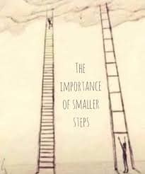
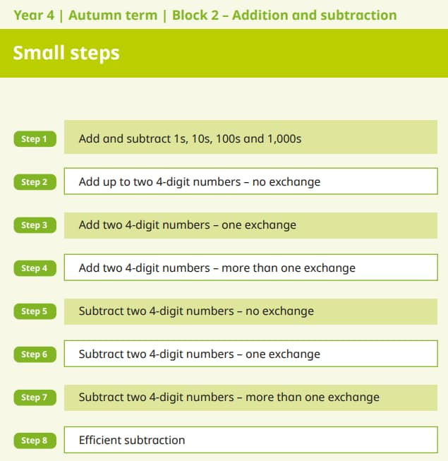
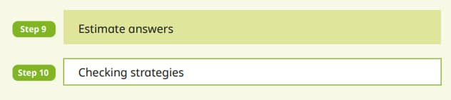
Small steps of progression
In Southfield Park, we follow the White Rose Maths and the small steps of progression.

Slide 5
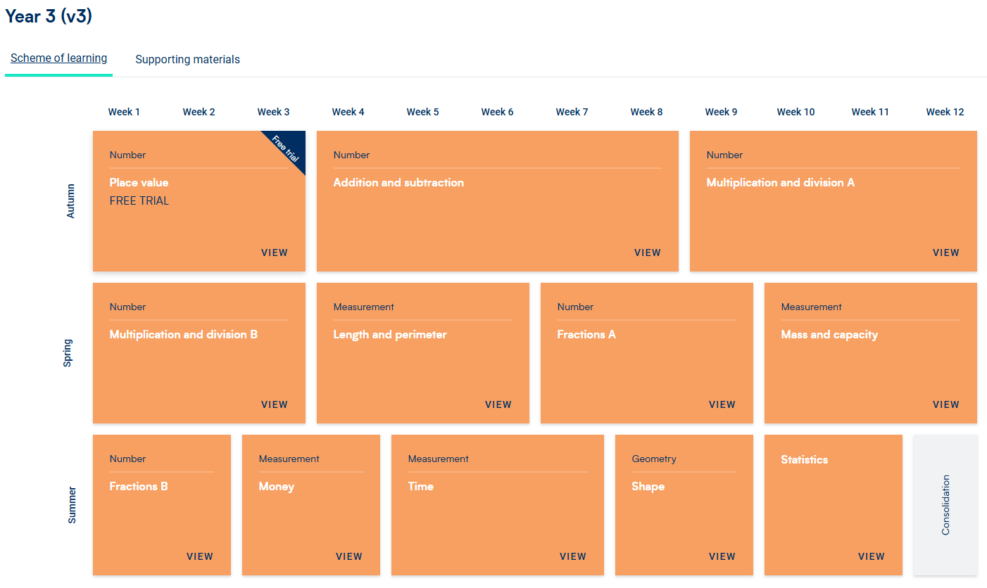
Year 3
You will be able to see this overview on the White Rose maths website under the parents and home learning page.

Slide 6
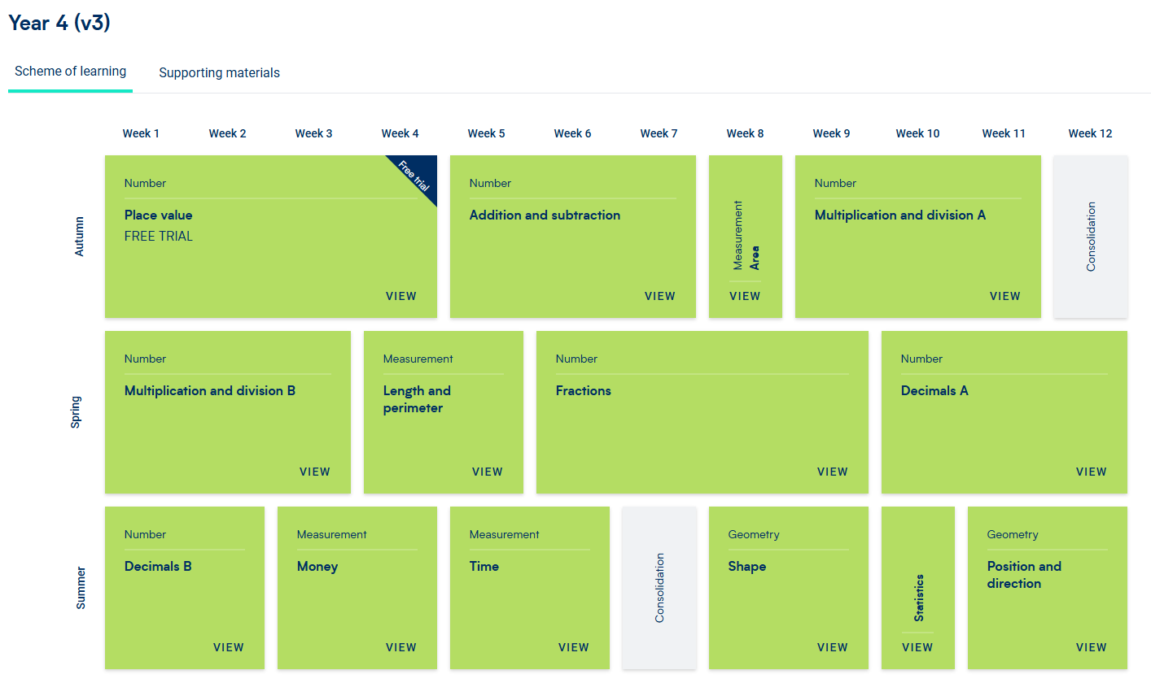
Year 4

Slide 7
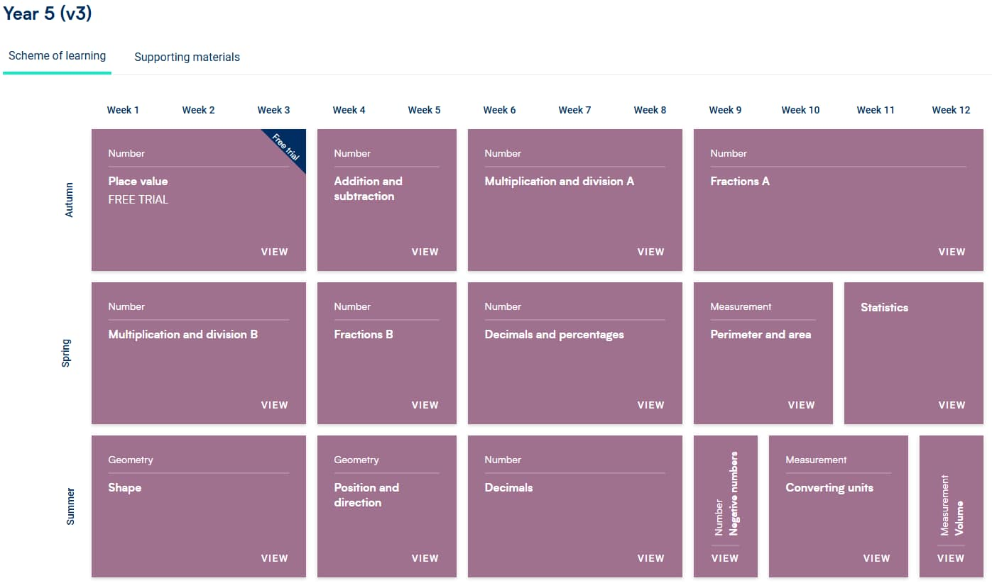
Year 5

Slide 8
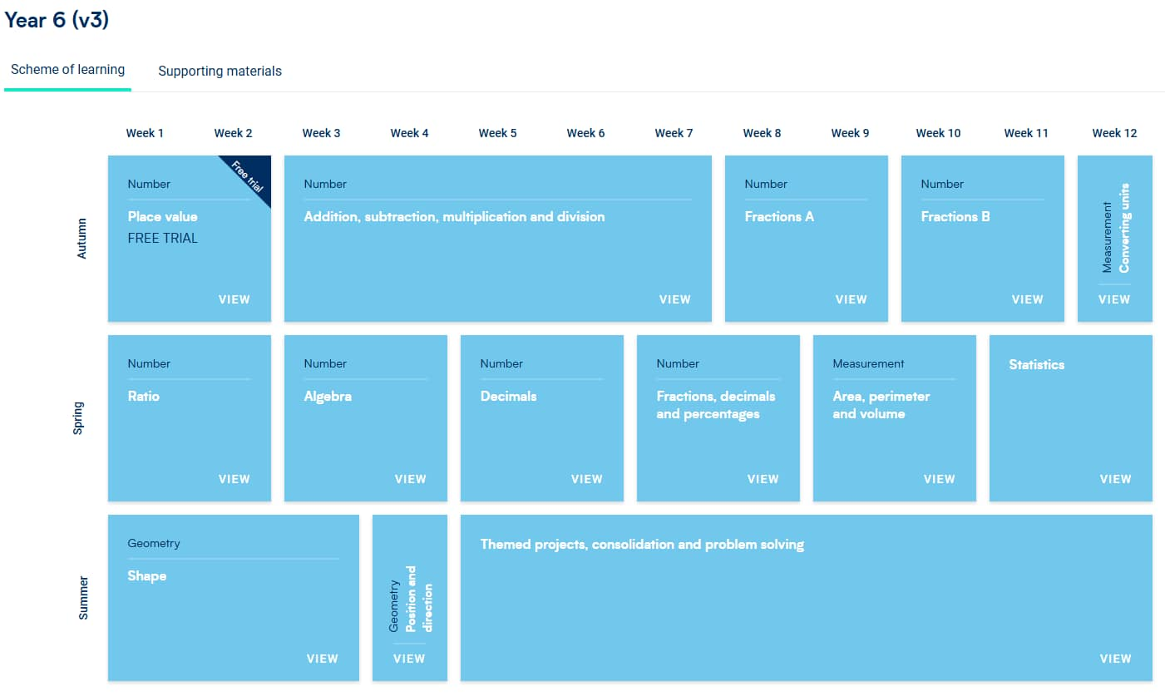
Year 6

Slide 9
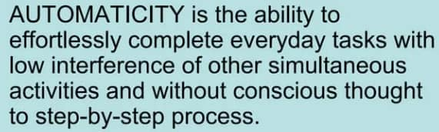

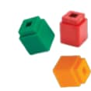
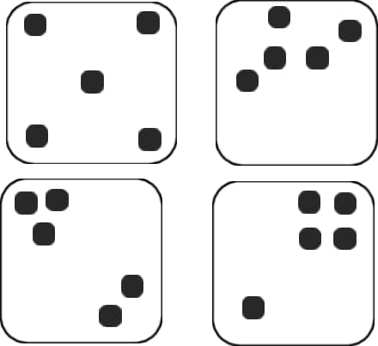



Automaticity
When children are fluent in their understanding of number bonds and times tables, it supports them to access the new concepts and methods more effectively.
Recognising numbers

Slide 10
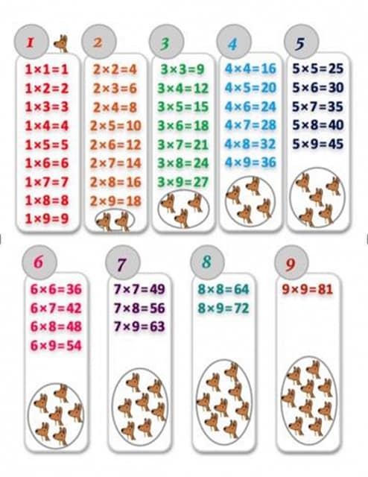
Automaticity
When children are fluent in their understanding of number bonds and times tables, it supports them to access the new concepts and methods more effectively.

Slide 11
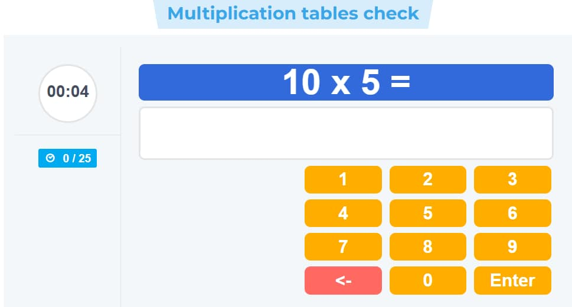
Year 4 multiplication times table checker
By year 4 children are expected to have learnt all of their times tables up to 12 x 12
6 seconds to answer
25 questions
Independently on a computer
https://www.timestables.co.uk/multiplication-tables-check/

Slide 12
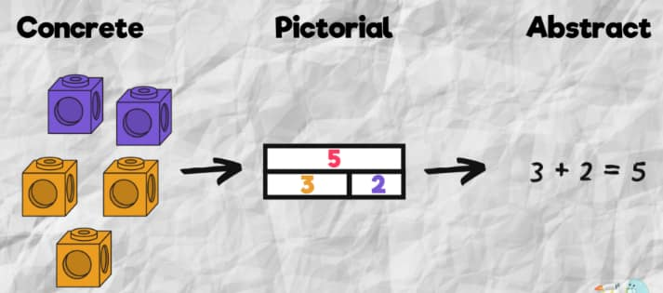
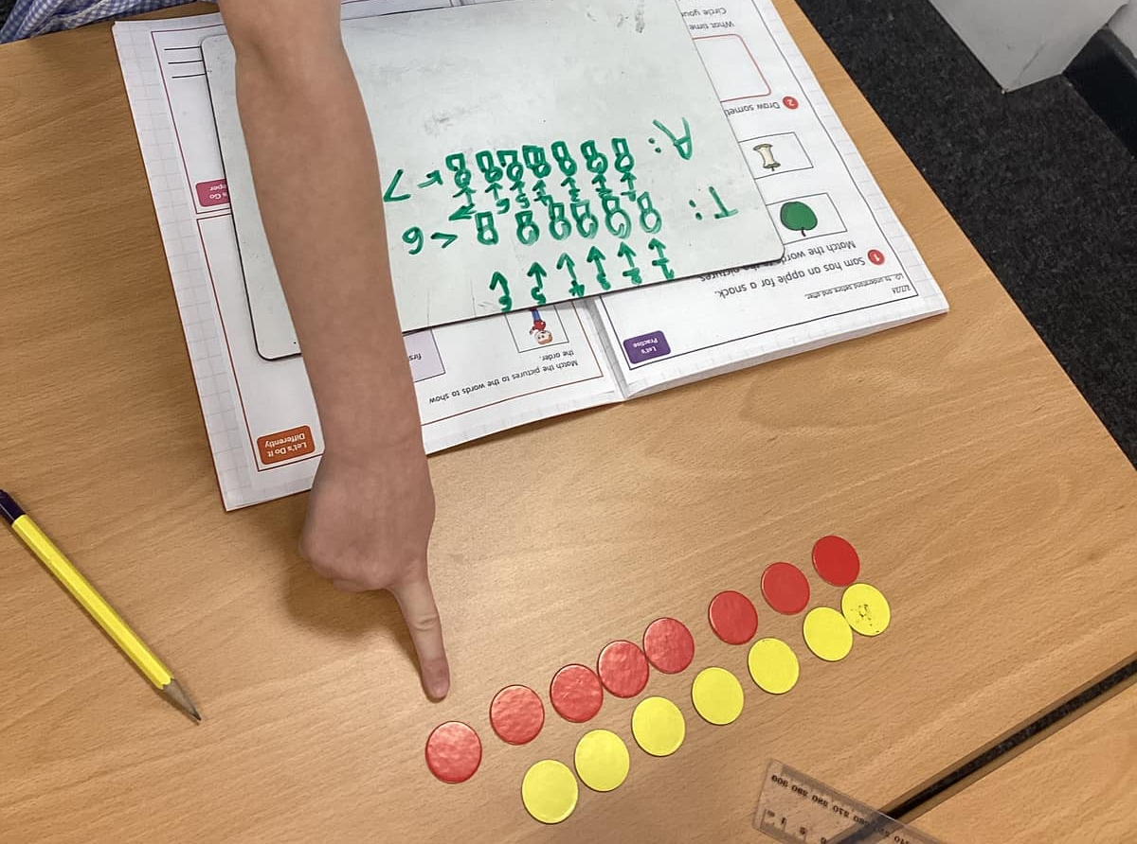
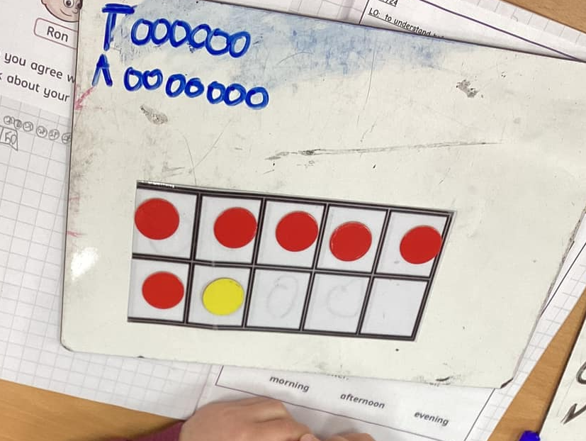
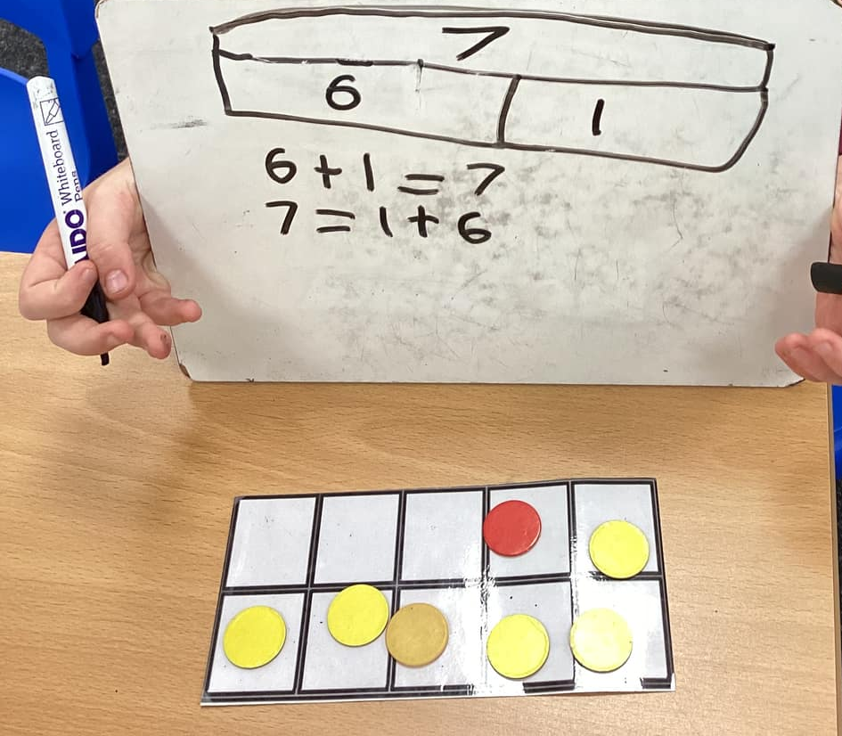
Concrete, pictorial and abstract
The concrete, pictorial and abstract approach is used in Southfield Park Primary School to secure your child’s understanding and prepare them for real life.
Here is an example of how we use the concrete, pictorial and abstract in our school.
Concrete
Pictorial
Abstract

Slide 13
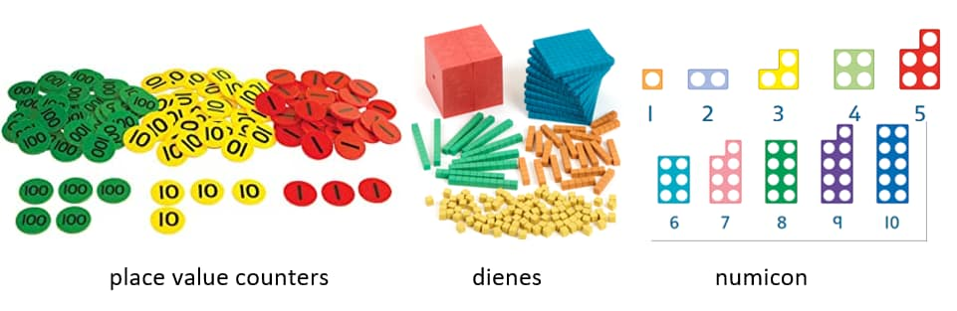
Concrete
The Concrete stage encourages the use of manipulatives (physical resources) to physically show the process behind what is being taught.
This can be as simple as using counters to represent numbers, allowing children to visualise the idea of more or less or comprehend what 3 (or any given number) actually is.
All of the main mathematical operations can be introduced and explored in this way.

Slide 14
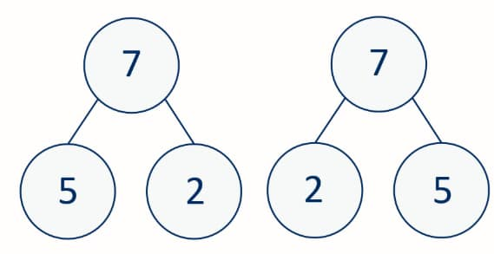
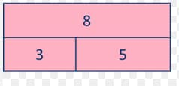
Pictorial
Once secure with understanding at the concrete stage, pupils move on to pictorial based problem-solving and expression. Teachers move the children on from using physical resources onto pictorial resources.
Pictorial support such as ten frames, bar models and part whole representations are used for pupils to show their understanding through answering questions using these visuals.
The pictorial stage is essential for learners to consolidate and secure their understanding of topics. It bridges the gap between getting to grips with a concept (quite literally) and knowing how to combat more abstract ideas.

Slide 15
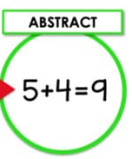
Abstract
The abstract stage is when children face questions using numbers and symbols, or key vocabulary alone. For example, 2+3 = 5
At this stage, pupils are expected to have a depth of knowledge which can now be applied without the need for physical or visual support strategies.

Slide 16
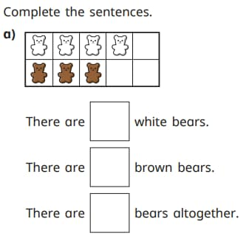
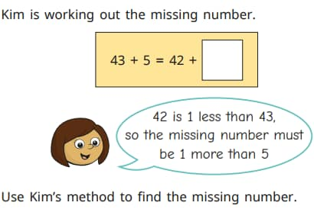

Fluency, reasoning and problem solving
Our lessons at Southfield Park involve fluency, reasoning and problem solving to deepen the children’s understanding.
Fluency
Reasoning
Problem Solving
Fluency the ability to calculate accurately and efficiently, while also having the flexibility to choose the best strategy for a given problem
Mathematical problem solving is the process of applying knowledge, logic, and reasoning to find a solution to a challenge that is not a routine exercise
Mathematical reasoning is the process of using logical thinking to solve problems, make connections, and justify conclusions

Slide 17
Vocabulary
Borrowing
Carrying
Exchanging

Slide 18
Let's try a lesson
Please join in with your whiteboard, pens, place value mats and counters.
Lesson : Year 4 : adding two four digit numbers with more than one exchange.
Lesson : Year 4 : Multiplying a three digit number by a one digit number.

Slide 19

White Rose Maths videos to use at home

Slide 20

White Rose Maths videos to use at home

Slide 21
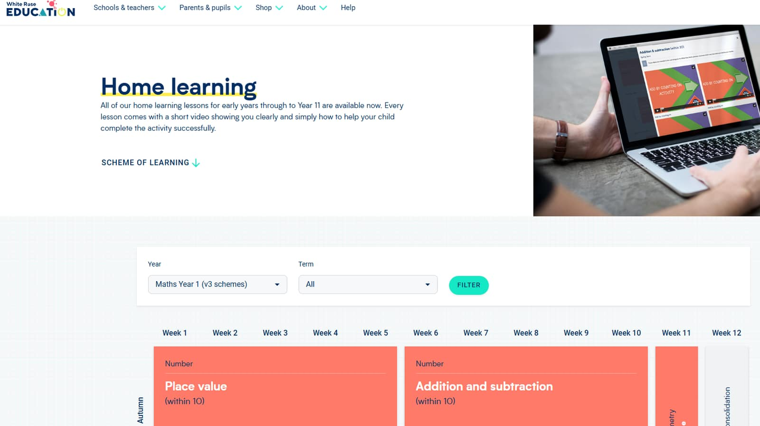
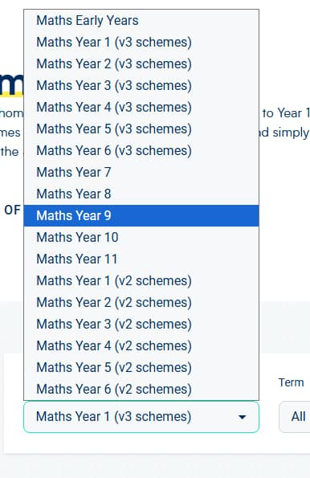
White Rose Maths videos to use at home
Select your child’s year group V3 means version 3.

Slide 22
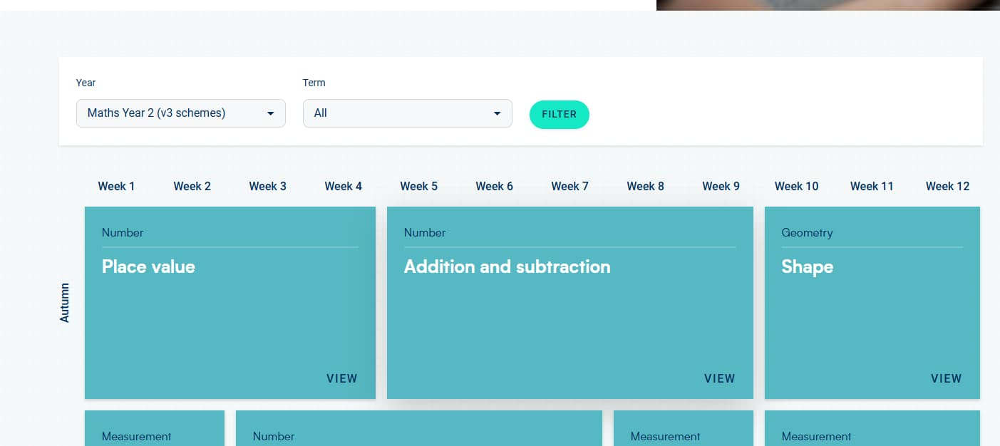
White Rose Maths videos to use at home
Once you have selected you year group you may click filter

Slide 23
White Rose Maths videos to use at home
You may then select the unit they are currently on.
This will be clear by the term down the side and the weeks along the top.

Slide 24
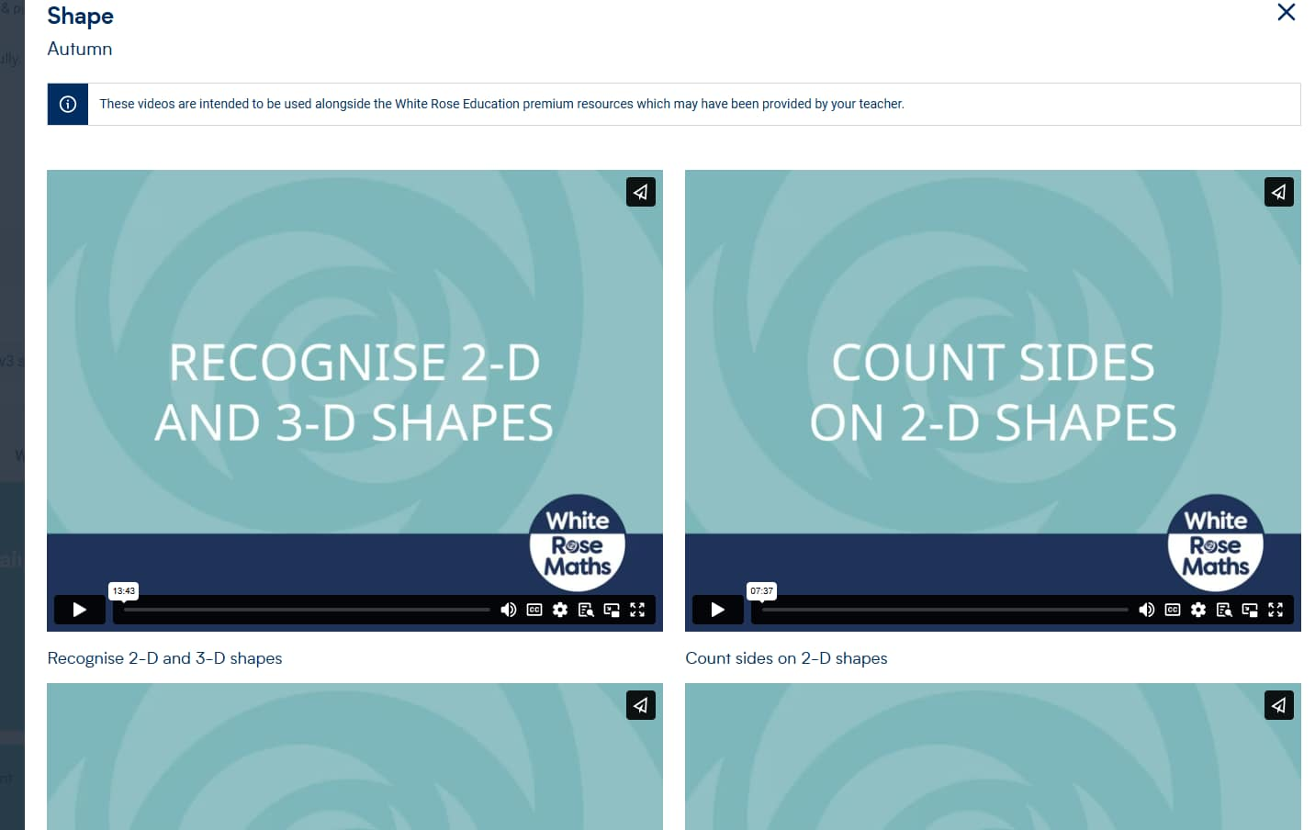
White Rose Maths videos to use at home
This will then show you a range of videos for each small step of the children’s learning.

Slide 25
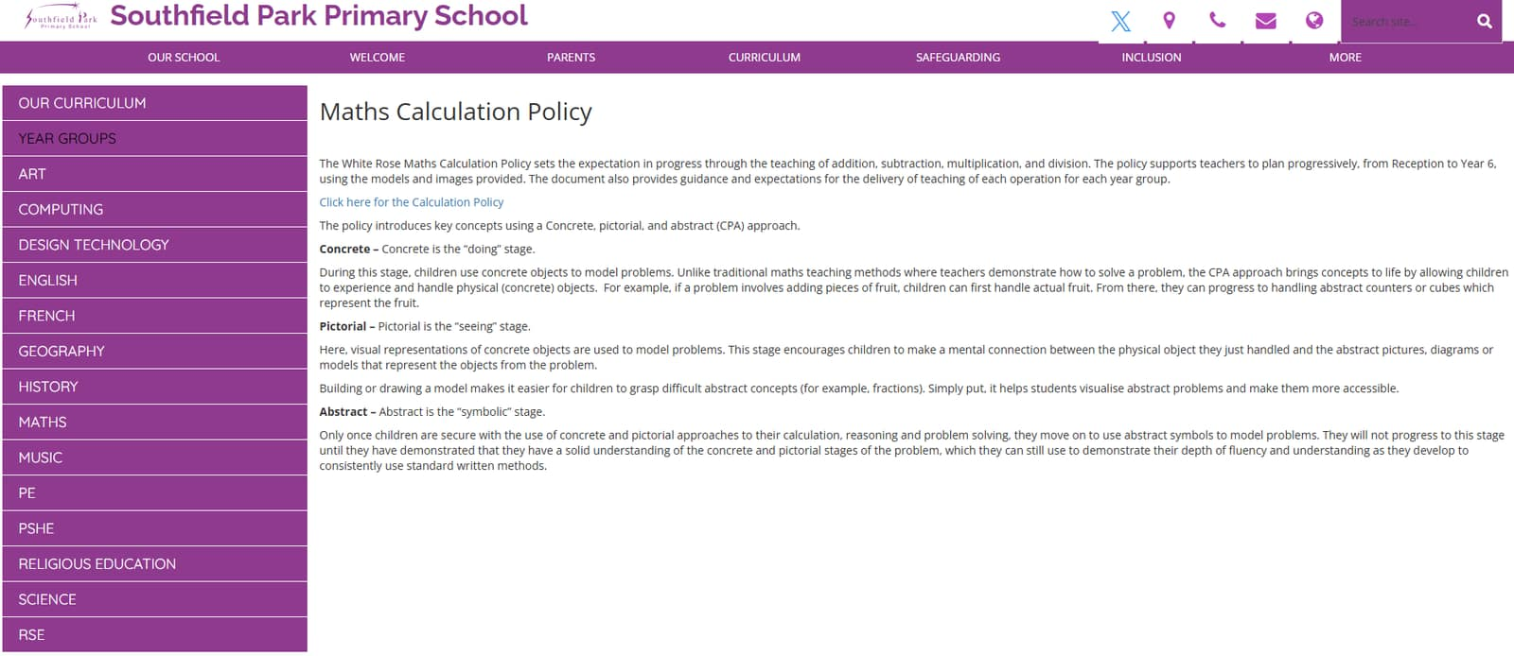
Calculations policy

Slide 26
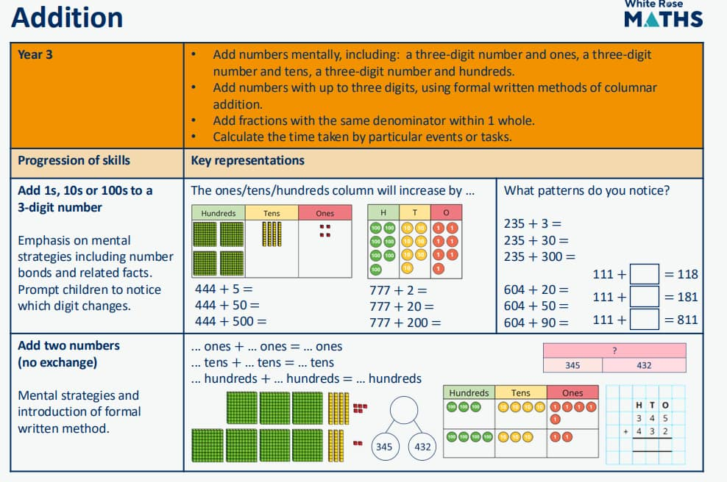
Calculations policy
https://assets.whiteroseeducation.com/new-schemes/WRM%20calculation%20policy%202024%20All%20year%20groups.pdf

Slide 27

How can I support my child at home?
TTRS
White Rose Maths – Home learning videos on the parent area
Counting stick - https://www.youtube.com/watch?v=TwsPx10HMy0

Slide 28
KS2 SATS In may of year 6
Arithmetic
Reasoning 2
Reasoning 3

Slide 29
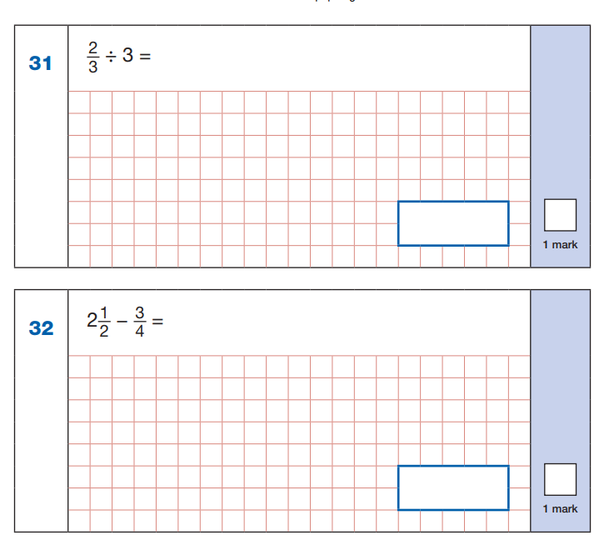
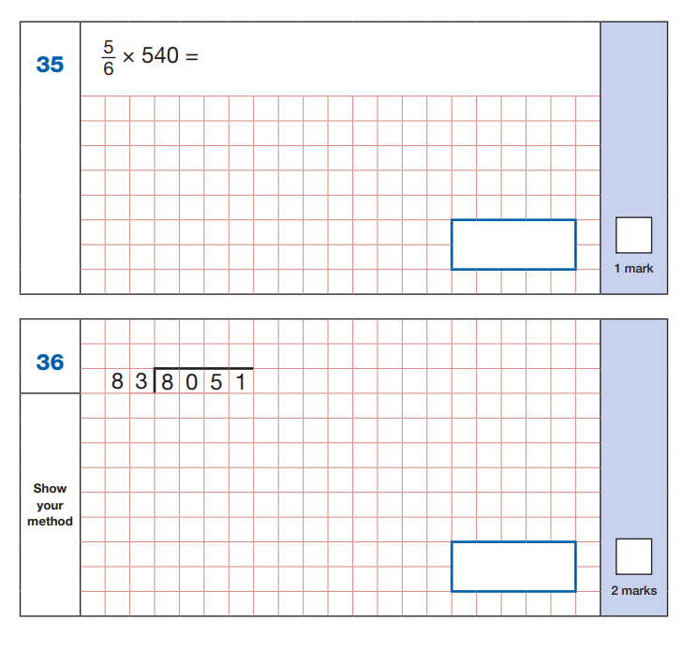
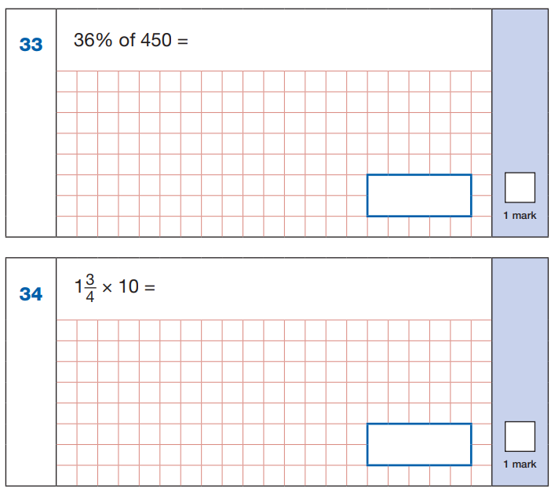
Arithmetic paper – 30 minutes – 40 marks

Slide 30
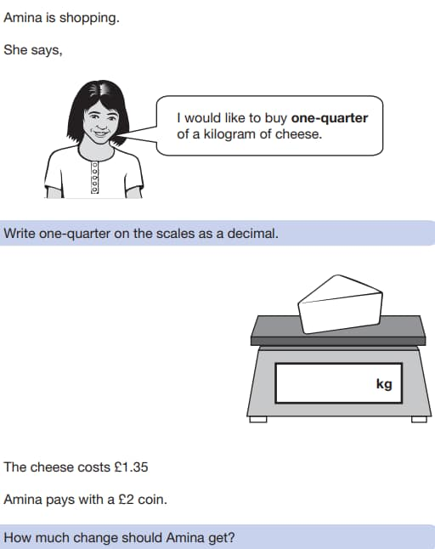
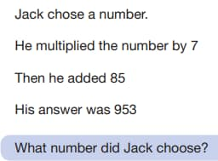
Reasoning 2 and 3 – 40 minutes each – 35 marks each

Slide 31

Any questions?

